Slide 1
HCSC Idea-a-thon Presentation Template

Slide 2
Member Cost Prediction and Segmentation Analytics
OPPORTUNITY / IDEA
RATIONALE
Describe the scope of the project:​
Identify different member's segments based on cost, risk & medical variables on the historical data.​
Predict high cost users, their total cost in the immediate future year and classify their risks to identify the member population for different intervention programs.
What is business need or pain points? ​
High cost users contribute to majority of healthcare costs. By identifying the high cost users total costs, classify their risks for the immediate future year and taking appropriate intervention programs like wellness, disease management & case management programs, costs can be effectively managed and reduced, provide appropriate care & efficiently allocate resources & improve health outcomes
What is the risk of not doing?​
Unmanaged costs​
Unmanaged allocation of resources
What is changing or retained
This is a new implementation
BENEFITS
ESTIMATE/COST
Forecast total costs & manage healthcare budgets ​
Improved utilization of resources​
Implement measures to prevent patients from ​becoming high cost users​
Provide appropriate care​
Recommend patients to different intervention ​programs
5500 person hours (approx.)
(Includes building data engineering pipelines & data science model effort)
| © 2018 Cognizant

Slide 3












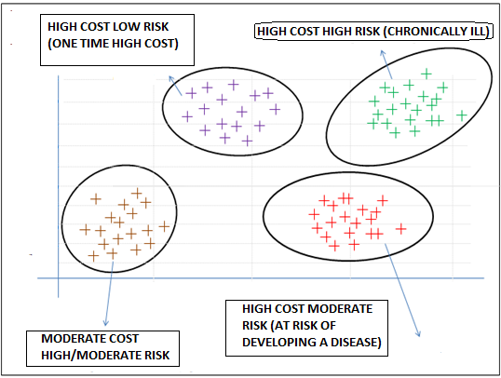

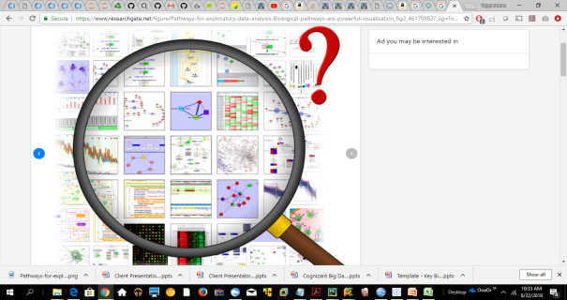








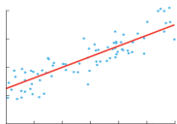

Solution Architecture
Source Systems
HCSC - Data lake
Membership
Raw Layer
Data Processing
Gold Layer
Data Processing
Consumption Layer
Rest APIs / Web Service
Membership
Demographics
Claims &utilization
Medical, Pharmacy
Vision, Dental
Claims &utilization
Analytic data Store
Clinical
Clinical
Lab, EMR
Others
Health Risk Assessment Data
Health Risk Assessment Data
Data Management, Scheduling, Security & Auditing
Data Science Platform - Dataiku
Stratify Members
Case Management program
Dimensionality Reduction - PCA
Model building, Evaluation & Optimization
Clustering
Uncover Underlying relationships,
distribution in the sample dataset,
identify trends, patterns, deviations & outliers
Transform variables, treat outliers and anomalies
Reduce Dimensions
High Cost
Disease Management program
Low Cost
Classification
Wellness Programs
Regression
Predict cost

